Slide 1
I've Got The Need, The Need To Read
Learning to Learn, one book at a time
Aaron M. Mann – Manager of Automation ENGINEERING @ American Equity mann.aaron@gmail.com

Slide 2

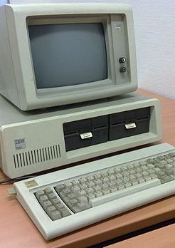

About Me
Iowa State Graduate in Computer Science
Started programming at age 11 on this. Yes, I am that old.
I play too much Destiny 2
Grew up in a small town in western Iowa.
Love test automation and improving software
Aaron Mann - mann.aaron@gmail.com @amann2112

Slide 3
Why Start reading
In order to stay relevant in an ever-changing profession.
“You’ve probably heard the phrase, “tech skills have a two-year half life.” It’s an idea we’ve embraced—and you should too. All technology depreciates as it gets older—from laptops and servers to code and information frameworks. And that means most tech experts need to replace or refresh about half of their skills every two years to stay current.” - Aaron Skonnard CEO Pluralsight
Gain an understanding from another point of view not your own.
We can learn from our own mistakes or someone else’s. It is cheaper to learn from someone else’s.
Uncover new technologies and techniques that have already been proven.
You don’t have to start from scratch. Build from other’s experiences.
Aaron Mann - mann.aaron@gmail.com @amann2112
Notes:
In the IT profession things change so rapidly that if you don’t devote some time to learning new technologies and learning you can find yourself limited in your opportunities.
There are so many books that you can leverage to gain insight and knowledge to so many topics.

Slide 4
How to get started
Find a subject that you want to gain a better understanding of and start there.
Ask friends what they are reading and why?
This is how I got pulled into my reading habit. - Thanks to Chris Waggoner
Here is what that looked like.
Aaron Mann - mann.aaron@gmail.com @amann2112
Notes:
Find an issue that is driving you crazy or something that you want to better understand and start googling and find something that relates to that topic.
Next find a way to consume the books. You just need to determine how you want to consume your books. e.g. buy books or audio books Amazon or check out libraries.
Video of Waggs pushing me to read more. First I was hesitant, but then it caught on.

Slide 5
Making the Time
I had an hour commute each, time for Audible
Make reading a part of your day
It doesn’t have to be a huge investment in time.
I averaged 1 hour and 24 minutes per day(weekdays only) for 15 months and completed 24 books.
Aaron Mann - mann.aaron@gmail.com @amann2112
Notes:
How do you find the time? You don’t. You must make a conscious decision to make the time.
I realized that I had at least two hours of time each day that I could devote to reading during my commute to and from work.
I chose to pick audible so I could “read” while driving. It was the best use of my time.
In our current circumstances I am trying to follow some advice from the book Atomic Habits and have switched to riding my exercise bike and listening to my books before I start my workday.

Slide 6
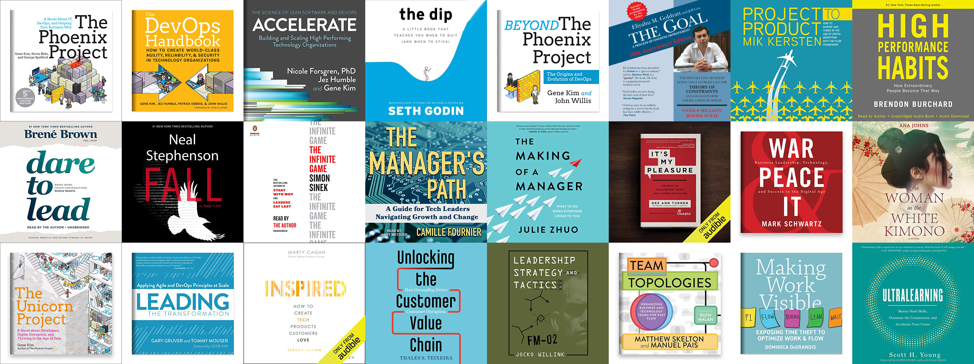
24 books in 15 Months
Aaron Mann - mann.aaron@gmail.com @amann2112
Notes:
After fifteen months I decided to look back and see what I had accomplished and was surprised to find that I had been able to finish more than a book a month.
And I really didn’t work too hard on this.
I started with the phoenix project since I had just been tasked with leading a DevOps transformation at work.
But after the first book I was hooked.

Slide 7
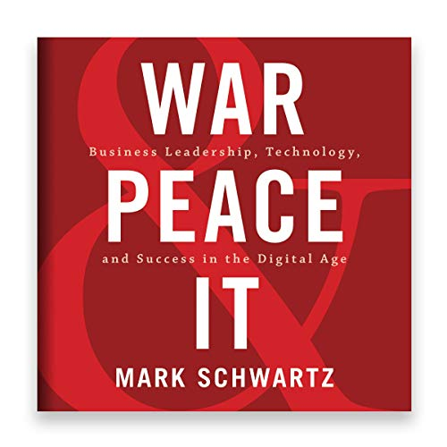
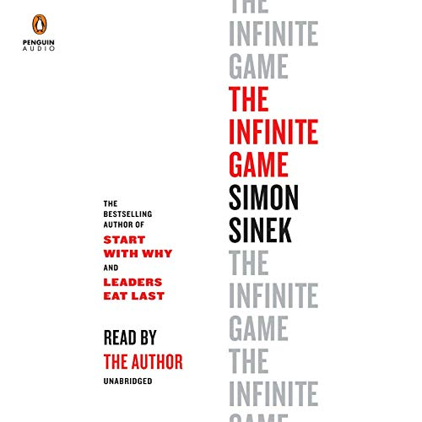
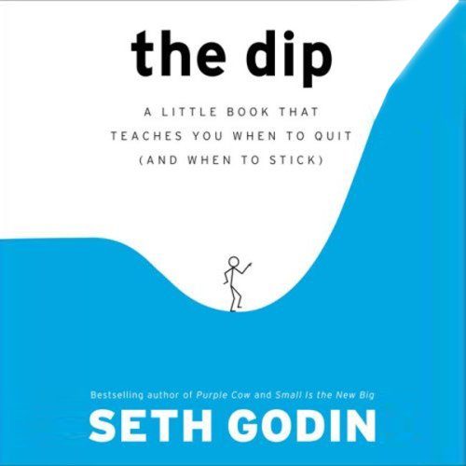
C SUITE
War and Peace and IT
The Infinite Game
The Dip
Aaron Mann - mann.aaron@gmail.com @amann2112
Notes:
I started reading a books from several different genres.
I first started reading books about devops and then turned my attention to some c suite material to help sell the devops strategies.
The book War & Peace & IT book was so good I bought copies for my entire management team and our entire C Suite.
I interoffice mailed these to them with a note asking that they read it and detailed the benefits that I believe the concepts in the book would bring to the organization.
After a couple of days our president sent a nice note back to me that he would read it. I will be following up with them again to see if they will give me some of their
time so we can discuss in person.
The Infinite Game is an excellent book for everyone as it details how to play the long game instead of playing to win.

Slide 8
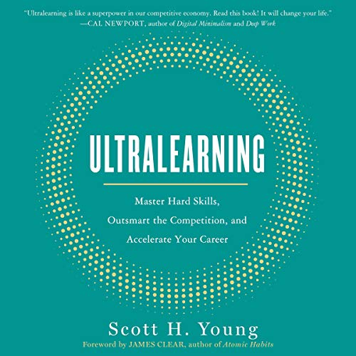
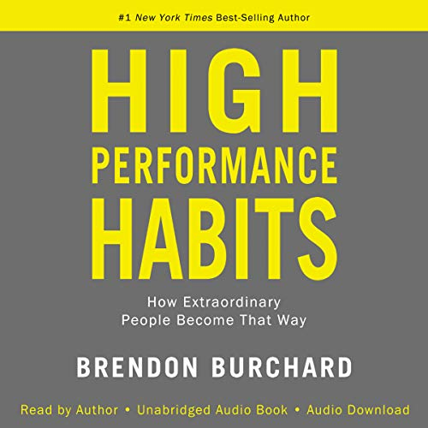
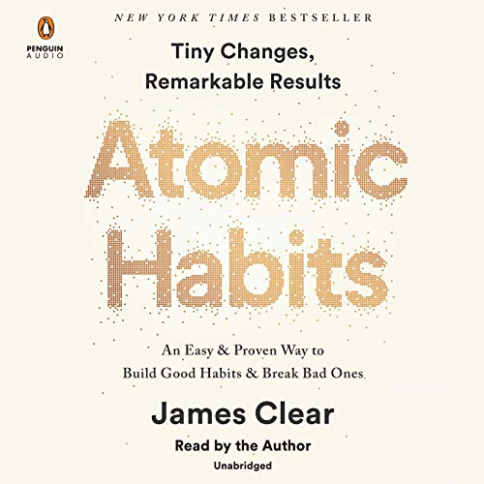
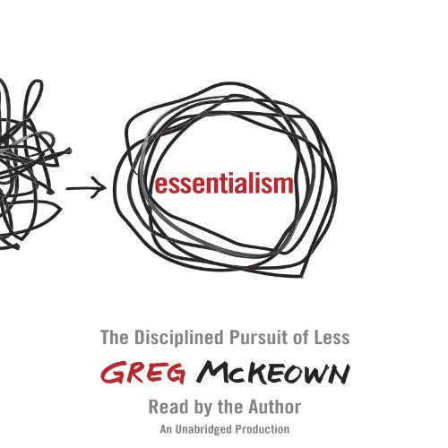
Self Improvement and Learning
Ultralearning
High Performance Habits
Atomic Habits
Essentialism
Aaron Mann - mann.aaron@gmail.com @amann2112
Notes:
I then started looking at some books on self improvement and learning.
The Ultralearning and Atomic Habits books I would highly recommend.

Slide 9
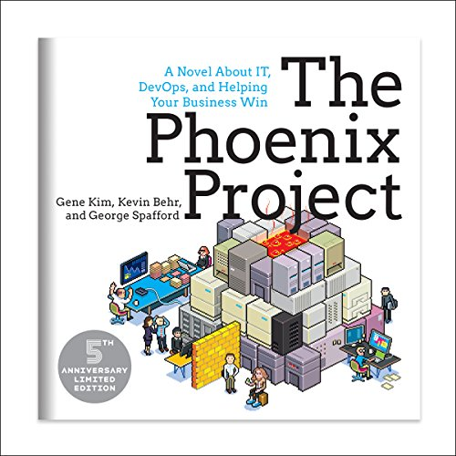
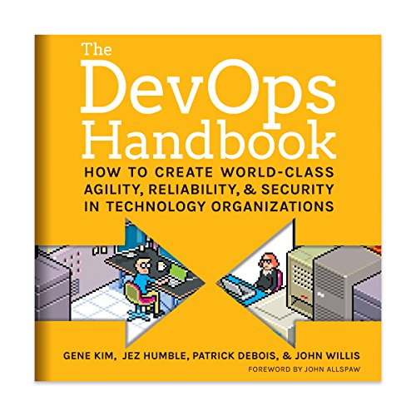
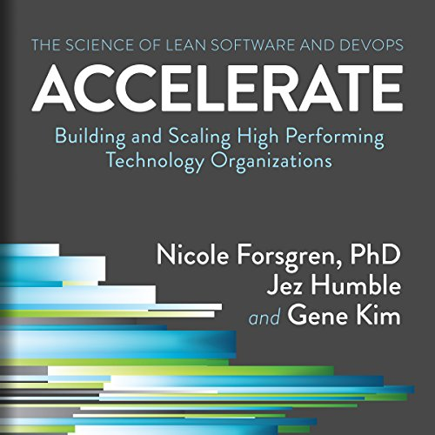
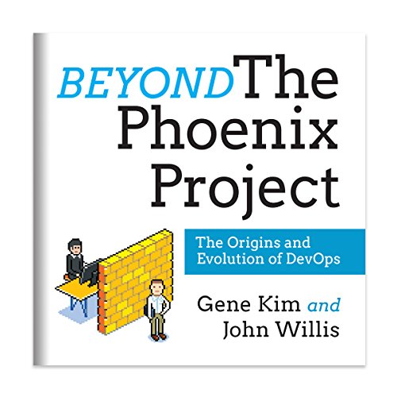
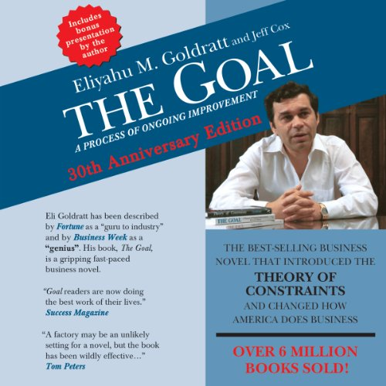
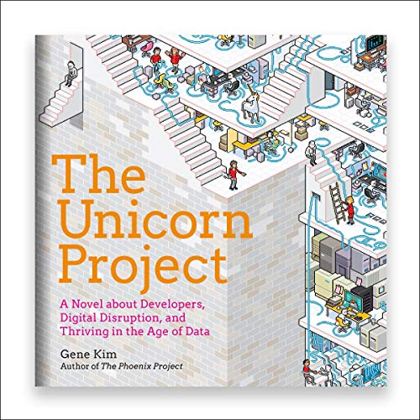
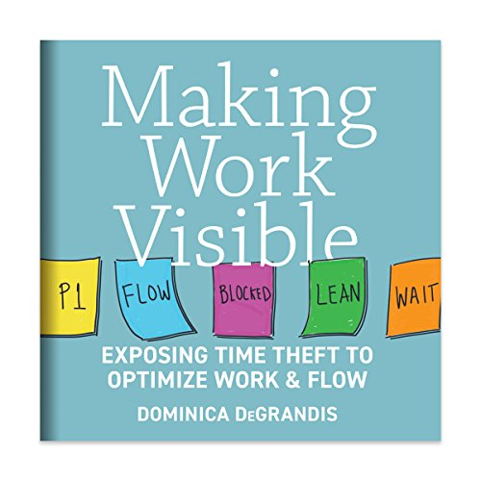
DEVOPS
The Phoenix Project
The DevOps Handbook
Accelerate: The science of DevOps
Beyond the Phoenix Project
The Goal
The Unicorn Project
Making Work Visible
Aaron Mann - mann.aaron@gmail.com @amann2112
Notes:
These are some of the best books on how to help make the transition your organization to one that practices DevOps methodologies.
I would also recommend any books from ITRevolutions press, they published all of these books except for the book The Goal.
They really understand the day to day struggles of the IT community.
After reading the Unicorn Project, I have decided that my new Alias will be Kurt Reznick as I really related to his character.

Slide 10
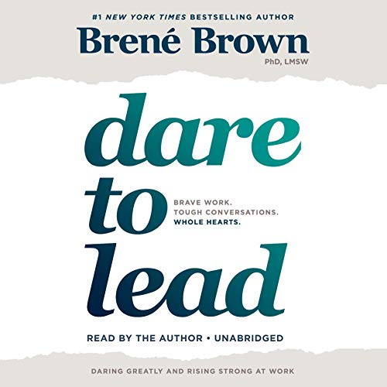
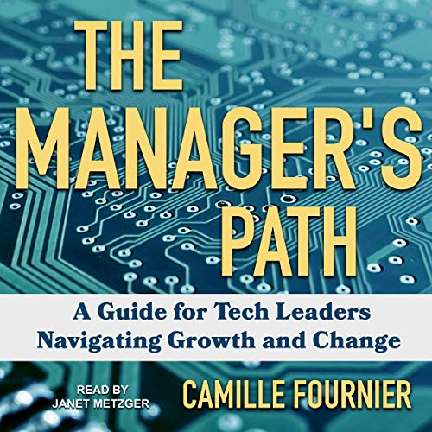
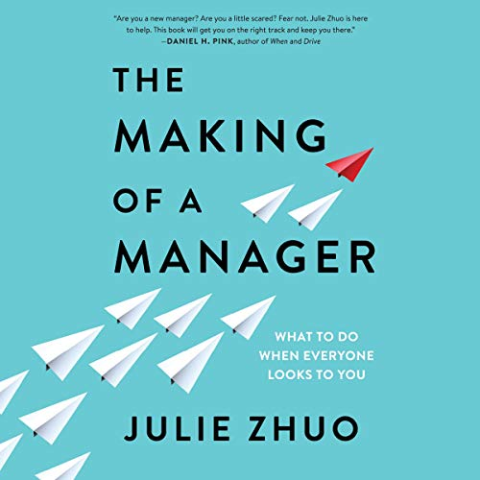
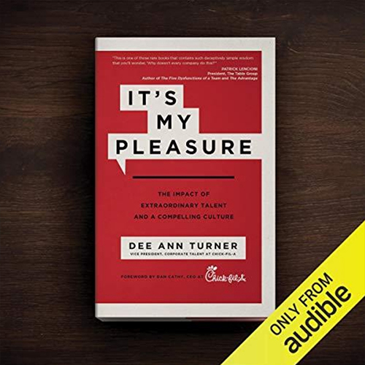
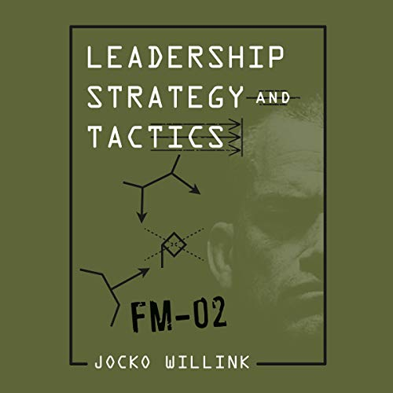
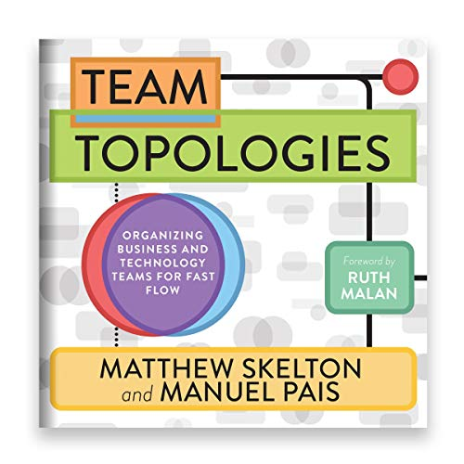
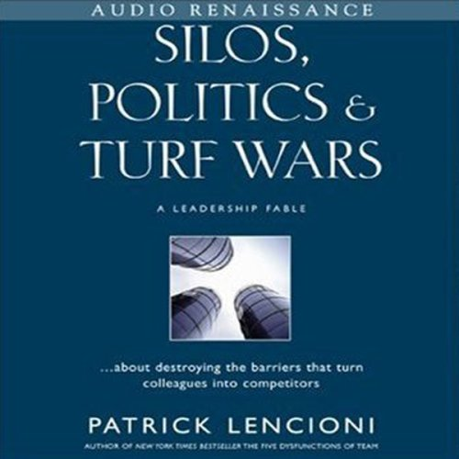
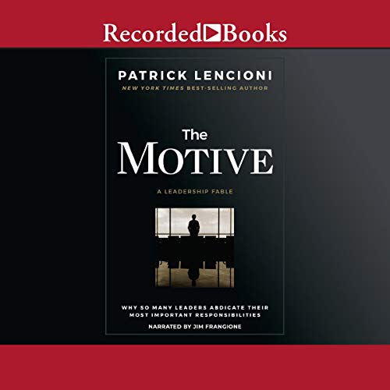
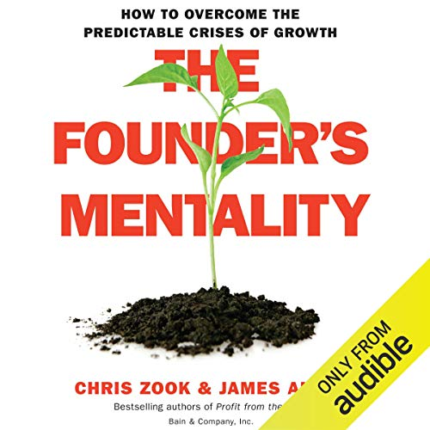
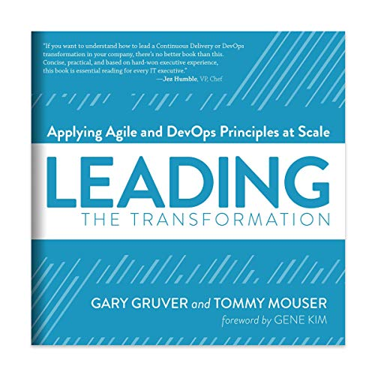
IT LEADERSHIP
Dare to Lead
The Manager’s Path
The Making of a Manager
It’s My Pleasure
Leadership Strategy and Tactics
Team Topologies
Silos, Politics, and Turf Wars
The Motive
The Founder's Mentality
Leading the Transformation
Aaron Mann - mann.aaron@gmail.com @amann2112
Notes:
Just to highlight a couple of the titles in this group
If you are in IT leadership I would recommend all of these books, but the ones that really stand out to me are.
The Manager’s Path and The Motive if you are just starting in a leadership role and you are struggling to determine if you want to follow that path or remain as an individual contributor.
If you are already in a leadership role the Team Topologies is a must read as it helps you recognize that the organizational structure of your teams will reflect your software architecture and does a deep dive on Conway’s Law

Slide 11
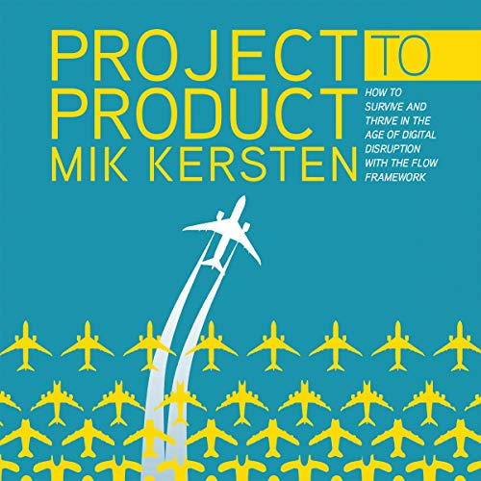
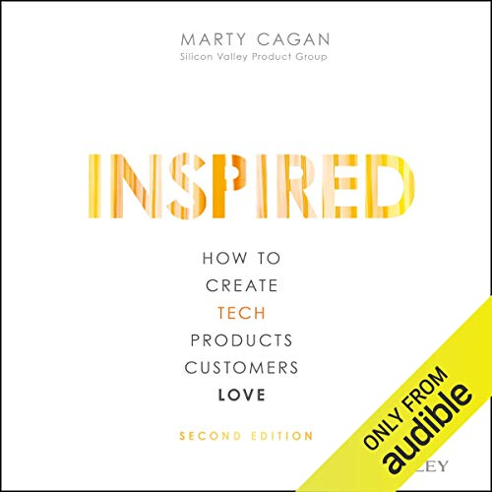
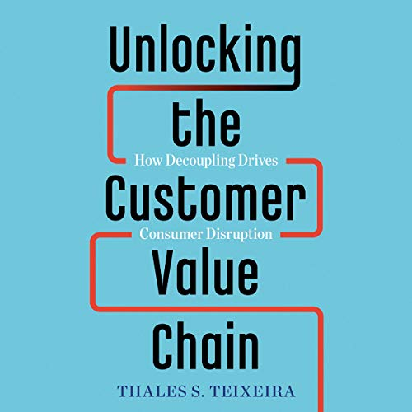
Product Management
Project to Product
Inspired
Unlocking the Customer Value Chain
Aaron Mann - mann.aaron@gmail.com @amann2112
Notes:
I chose these books to get a better understanding of how we should think about the work that we do from the perspective of it being a product.
If you have any scrum masters or product owners in your organizations you should really get these books in their hands.

Slide 12
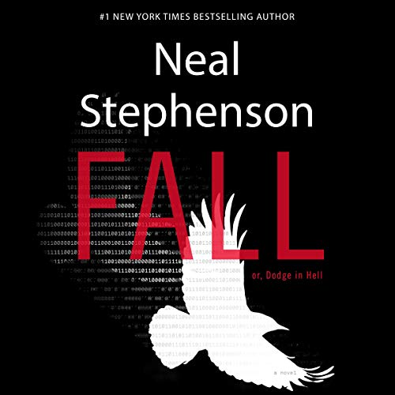

Leisure
Fall; or, Dodge in Hell: A Novel
The Woman in the White Kimono
Aaron Mann - mann.aaron@gmail.com @amann2112
Notes:
I don’t always read just for work or to help me improve my craft occasionally I read just for the enjoyment of it.
The author Neal Stephenson has always been one of my favorites and Fall; or, Dodge in hell: A Novel is one of his best.
He dives into the singularity and how the creative spirit of software development transcends even death.
The woman in the white kimono is a book that was suggested by my father and it was quite eye-opening for me since it related quite closely
to his own experiences in Japan.

Slide 13
How to reach me
@amann2112
mann.aaron@gmail.com
Always love to talk about books, software development, technology, photography and gaming.
Aaron Mann - mann.aaron@gmail.com @amann2112

